Slide 1
ST25SDK (ST25 Software Development Kit)
Architecture overview document v1.0
August 11th 2017 MDG/MMY RFID Application Ecosystem team

Slide 2
ST25SDK Requirements
Support of several readers with the same application (reuse of UI developments)
Software library to be used in Java applications
Can be run any platform supporting JVM (Windows, Android, Linux)
MacOs under reviewed
iOs some components can be re-used.
Easy-to-use model of RF tags, including ST’s specific features
Supports all features of new tags from ST25 family
Supports all ST portfolio and generic Iso/NFC tags

Slide 3
ST25SDK Requirements
Useful to different types of users:
Industrial/commercial multi-tag applications
Smartphone single tag applications
Tag validation
Ability to share source code with customers
Delivered as Java .jar library or
Source code available through Mix MyLiberty License:
Allows to share ST source code
Delivers library for 3rd party software (crypto, etc)

Slide 4
Architecture/Design Requirements
Quick to update for new products
New tags
New readers
Object oriented development
Structure code around tags and readers
Global reader instance whose properties get updated throughout the lifetime of the application
Global tag instance updated throughout the lifetime of a RF or I2C session
Tags have common properties
Specific fields and methods for tags that have extra features or different from base tags
We do not reinvent the wheel every time, just add or override fields and methods
Inherit features based on tag hierarchy
Cross platforms/readers support
Easy to sandbox from SDK an ST tag
Cache tag information (useful when RF field is OFF)

Slide 5
ST25SDK ARCHITECTURE
Overview

Slide 6
Architecture overview
Application accesses the ST25SDK library through several APIs
Low Level API
High Level API
instantiates
instantiates
instantiates
uses
Custom
M24LR64E
ISO 14443/15693
ST25DV
TagHelper
NFC Forum
ST25TA02K
NDEF
Helper
called
by
called
by
Commands
Tags
Ndef records
Helper
classes
used by
RF Reader Interface
implements
Reader implementation(s) based on Interface template

Slide 7
API Layers
API levels:
Commands (low)
Tags (highest)
Ndef
Readers
An application using the ST25SDK must:
Instantiate a Command class object to access RF command methods OR
Instantiate a NFCTag object to access generic and tag-specific methods OR
Instantiate an Ndef class
The RF reader interface must
Provide at least one reader implementation, used for Command and Tag layers
Application
Tags
Java layers
Commands
SDK
Ndef
RF Reader interface
App
reader 1
App reader 2
App
reader n
Java/C/C++ layers

Slide 8
Command API
RF commands:
Low level RF commands, very close to standards and datasheets
Easy to work with multiple tags
Very little extra processing
Commands are separated in
Ndef commands calling on unitary commands
Unitary commands corresponding to:
NFC Forum RF commands from specifications
Iso14443/15693 commands from specifications
Tag-specific commands from datasheet
Iso7816 commands from specifications
Application
Unitary commands
Reader Interface
Reader Implementation

Slide 9
Tag API
The Tag API is the highest level of API to work with a single tag
It contains the supported RF commands
High level commands are also available, such as readBlocks() that will manage reading through areas, using readMultiple commands when supported, etc.
TODO: Explain inheritance hierarchy:
NFCTag -> Type5Tag -> STType5Tag -> STType5MultiAreaTag-> ST25DVTag
Tags are implemented in the application based on the product identified using a SDK helper command
Example:
productName = TagHelper.identifyProduct(readerInterface, uid); switch (productName) {
case PRODUCT_ST_ST25TA02K:
recognizedTag = new ST25TA02KTag(readerInterface, uid);
break;
case PRODUCT_ST_ST25TA16K:
recognizedTag = new ST25TA16KTag(readerInterface, uid);
break;

Slide 10
Ndef API
The Ndef API allow
To parse NDEF from raw bytes
To create/edit/read/write NDEF with well known records
To manage multiple records
It is used by ST25 tags but can also be used to address multiple tags simultaneously

Slide 11
RF Reader Interface
The RF reader interface can be seen as the porting layer of the ST25SDK. Each reader must implement the SDK’s readerInterface methods
Some examples of implementation are delivered with the SDK: Android, CR95HF, ST253911 and Feig
Android app
PC Java app
SDK
RF Reader interface
ret transceiver(data)
decodeTypeTag(uid)
Impl. reader 1
Impl. reader 2
Impl. reader n

Slide 12
Architecture overview
The split in different isolated layers allows:
To fully reuse an application on different platforms (e.g. the new ST25PC application run on Windows, Linux with different readers)
To reuse a reader implementation for different applications (e.g. the RF reader implementation for CR95HF is used by different UI applications)
To isolate and easily reuse some layers (e.g. the NDEF layer is used on iOs)

Slide 13
ST25SDK DESIGN
V0.5.5

Slide 14
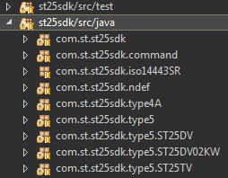
SDK Code Organization
ST25 SDK is made of several java packages
st25sdk root folder contains:
st25sdk.command:
st25sdk.ndef
st25sdk.type5
st25sdk.type4A
iso14443SR
st25sdk build is a jar library
RF Reader interface implementations delivered with SDK (for ST253911B, CR95HF and Feig) are made of java classes and java native interface in C/C++. For Android, the SDK is used.

Slide 15
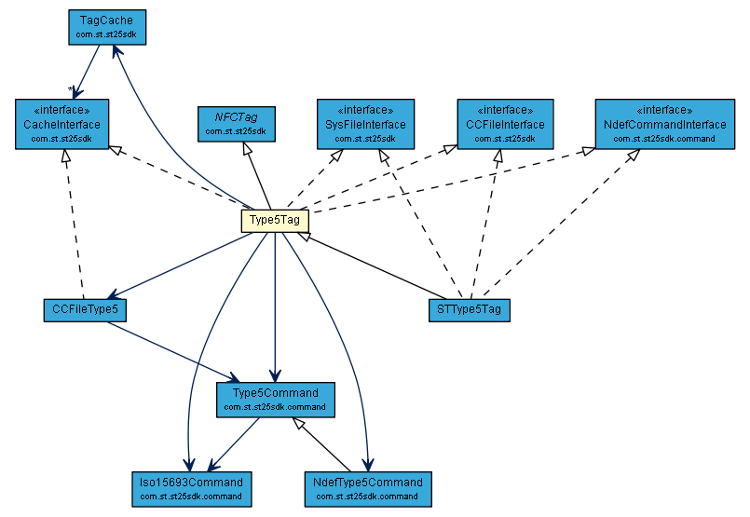
Class Hierarchy
UML graphs delivered with the Javadoc explain class hierarchy Example for Type5Tag:

Slide 16
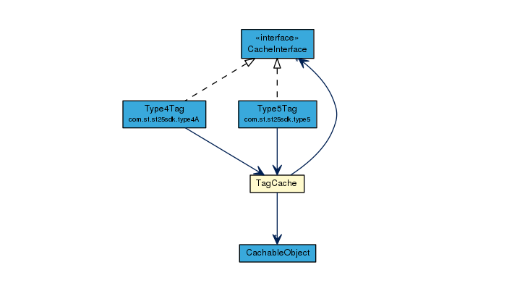
Tag Cache
An internal cache system allows to keep tag information when the tag is not in the reader field
Each tag has a cache in which object members (implementing or not the cache interface) can be added/removed

Slide 17
Android/iOS Support
Android:
The RF reader interface implementation is directly plugged on Android SDK APIs making it thin.
iOs:
A tool named j2objc to convert the ST25SDK Java code to Objective C:
« J2ObjC is an open-source command-line tool from Google that translates Java source code to Objective-C for the iOS (iPhone/iPad) platform. »
Ndef package of ST25SDK is re-used for the ST25 iOs application

Slide 18
Professional readers Support
ST253911B:
The RF reader interface implementation is done through jni classes C/C++
Build with gcc on Windows (no support so far on Linux)
CR95HF
The RF reader interface implementation is done through jni classes C/C++
Build with gcc on Windows and Linux with usb-hid backend
Feig:
The RF reader interface implementation is done in java with proprietary classes delivered by Feig

Slide 19
Open Source strategy
All the code source is available on st25.com

